Slide 1
MiniHackathon-1
Presented by
AKSHAIYA.M

Slide 2
HALLOWEEN DATASET
Predict the Price

Slide 3
BUSINESS UNDERSTANDING
Halloween is a festival which is celebrated on 31st of October. People get dressed up like a scary ghosts
This data set focuses on a Halloween celebration happening in a neighbourhood.
Inspite of games, there are also 50 stalls in the neighbourhood.
Here the aim is to predict the price of the product which will get sold based on the various features

Slide 4
DATASET
Feature | Description | Data Type
Product_id | Unique ID of each product | object
Stall_no | Represents the number of stalls in the carnival (1-50) | int64
instock_date | Represents the date and time on which the product was bought | object
Market_Category | Represents the different market categories that the products belong to | int64
Customer_name | Represents the names of the customers | object
Loyalty_customer | Represents if a customer is a loyal customer | object
Product_Category | Represents the 10 different product categories that the products belong to | object
Grade | Represents the quality of products | int64
Demand | Represents the demand for the products being sold at the carnival | int64
Discount_avail | Represents whether a product is being sold at a discount or not | float64
charges_1 | Represents the types of charges applied on the products in the carnival | float64
charges_2 (%) | Represents the types of charges applied on the products in the carnival | float64
Minimum_price | Represents the minimum price of a product | float64
Maximum_price | Represents the maximum price of a product | float64
Selling_Price | Represents the selling price of the product in the carnival | float64

Slide 5
DESCRIPTIVE ANALYSIS
The data set contain 3 CSV files
train.csv
test.csv
sample_submission.csv
The predicted data should be in the form of CSV file with Product Id and Selling Price as columns

Slide 6
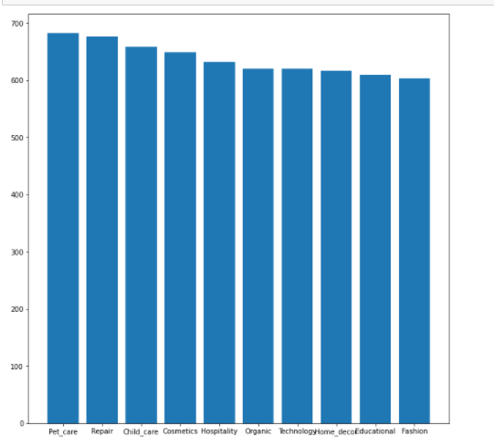
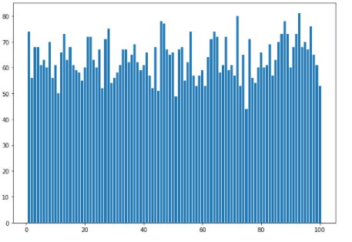
DESCRIPTIVE ANALYSIS USING EDA
The plot shows the distribution of product category
The plot shows the distribution of demand

Slide 7
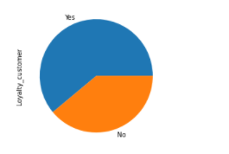
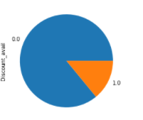
DESCRIPTIVE ANALYSIS USING EDA
The plot shows the distribution of loyal customer
The plot shows the distribution of whether the product is sold with discount or not

Slide 8
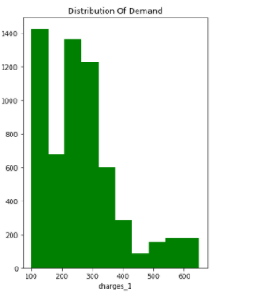
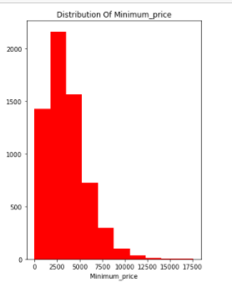
DESCRIPTIVE ANALYSIS USING EDA
The plot shows the distribution of charges
The plot shows the distribution of Minimum Price

Slide 9
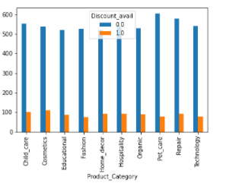
DESCRIPTIVE ANALYSIS USING EDA
The plot shows the discount availed or not for the specific product category

Slide 10
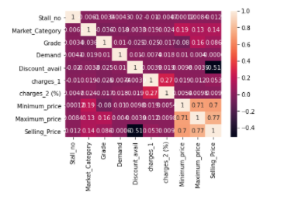
CORRELATION BETWEEN FEATURES

Slide 11
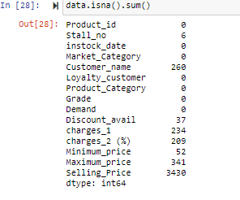
STEPS IN PREPROCESSING
For the processing purpose , train and test data has been concatenated
There are nulls in some columns such as Stall_no , Customer_Name,Discount_Avail,charges_1,charges_2(%),Minimum Price , Maximum Price
There was 41 nulls in Selling_Price in train data.As the train data mainly focusses on the target data,the nulls in the Selling_Price column is dropped and then concatenated with test data.

Slide 12
Stall_no column in the data set is filled with mode as mean or median may give float values
Customer_name in the data set is filled with mode as it is a categorical column
Discount_avail in the data set is filled with mode as the discount availability is described as 0 means product sold with no discount and 1 means product sold with discount. Here the mode is 0.So the null columns were filled with 0
Charges_1 and Charges_2 (%) column are filled with mean values.
Minimum price and Maximum price of the product has outliers . So filled the columns with the median values.
Segregated the numerical and categorical columns
Scaled the numerical columns using Standard Scaler except the target data and few features and scaling is not required for them.
Processed the categorical data by adding dummies except the Product Id.
Concatenated both the processed numerical and categorical data with the Product Id
Separated the train and test columns and made it into a CSV file

Slide 13
ALGORITHM USED
Linear Regression
Lasso Regression
Ridge Regression
Elastic Net Regression
KNN Regression

Slide 14
Hyper Parameter Tuning in Algorithm
In KNN Regression, substituted different values of K and analysed the RMSE values
While analysing the values , k=6 has the good score compared to other values present below
K-value | RMSE value | Score = max(0,100-RMSLE(actual_values-predict_values))
KNN(k-value=1) | 399.4633731 | 7.9777
KNN(k-value=2) | 972.2017686 | 8.04162
KNN(k-value=3) | 1174.736477 | 7.91383
KNN(k-value=4) | 1256.394061 | 7.70702
KNN(k-value=6) | 1372.082546 | 7.48714

Slide 15
Algorithm and their Scores
Algorithm | RMSE value | Score = max(0,100-RMSLE(actual_values-predict_values))
Linear Regression | 931.4252787 | 9.90968
Lasso Regression | 932.0803513 | 9.95123
Ridge Regression | 931.7931143 | 9.89065
Elastic Regression | 1668.778146 | 6.98246
KNN Regression(k=5) | 1322.038806 | 7.56063

Slide 16
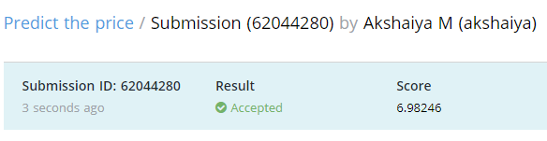
Score
Efficient Algorithm : ElasticNet Regression

Slide 17
THANK YOU

